Slide 1
C# Fundamentals
Reviewing Basics

Slide 2
C# Fundamentals Table of Contents
Variables
Data Types
Access Modifiers
Operators
Control Structures

Slide 3
C# Fundamentals Variables
A variable is nothing but a name given to a storage area that our programs can manipulate. Each variable in C# has a specific type.
Integer
Floating point types
Decimal types
Boolean types
Nullable types

Slide 4

C# Fundamentals Variables
Defining Variables
int i, j, k;
char c, ch;
float f, salary;
bool b, status;
double d;
Initializing Variables

Slide 5
C# Fundamentals Data Types
Value Types
Variables that are based on value types directly contain values. Assigning one value type to another copies contained value.
e.g bool, char, int, decimal, etc.
Reference Types
The reference types do not contain the actual data stored in a variable, but they contain a reference to the variables.
Built-in reference types are : object, dynamic, and string.
User-defined reference types are : class, interface, or delegate.

Slide 6
C# Fundamentals Data Types
Implicitly Typed Local Variables
Local variables can be given an inferred "type" of var instead of an explicit type.
The var keyword instructs the compiler to infer the type of the variable from the expression on the right side of the initialization statement.
var cannot be used on fields at class scope.
var can only be used when a local variable is declared and initialized in the same statement; the variable cannot be initialized to null.

Slide 7
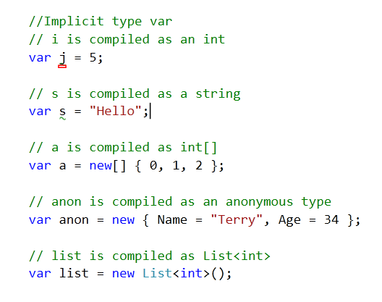
C# Fundamentals Data Types
Implicitly Typed Local Variables

Slide 8
C# Fundamentals Data Types
Anonymous Type
Anonymous types provide a convenient way to encapsulate a set of read-only properties into a single object without having to explicitly define a type first.
The type name is generated by the compiler at is not available at the source code level.
You create anonymous type by using the new operator together with an object initializer

Slide 9
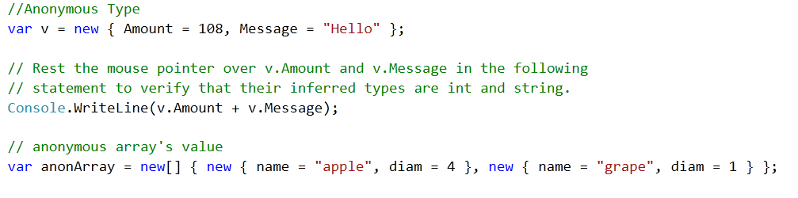
C# Fundamentals Data Types
Anonymous Type

Slide 10
C# Fundamentals Access Modifiers
public
Access is not restricted.
internal
Access is limited to the current assembly.
protected
Access is limited to the containing class or types derived from the containing class.
private
Access is limited to the containing type.

Slide 11
C# Fundamentals Operators
Arithmetic Operators
Operator | Descripcion | Example
+ | Adds two operands | a+b = 20
- | Subtracts second operand from the first | a-c = 10
* | Multiplies both operands | a*c = 200
/ | Divides numerator by de-numerator | a/c = 2
++ | Increment operator increases integer value by one | a++ = 11
-- | Decrement operator decreases integer value by one | a-- = 9

Slide 12
C# Fundamentals Operators
Relational Operators
Operator | Descripcion | Example
== | Checks if the values of two operands are equal or not. | (A==B) is not true
!= | Checks if the values of two operands are equal or not. | (A != B) is true
> | Checks if the value of left operand is greater than the value of right operand. | (A > B) is not true
< | Checks if the value of left operand is less than the value of right operand. | (A < B) is true
>= | Checks if the value of left operand is greater than or equal to the value of right operand. | (A >= B) is not true
<= | Checks if the value of left operand is less than or equal to the value of right operand. | (A <= B) is true

Slide 13
C# Fundamentals Operators
Logical Operators
Operator | Descripcion | Example
&& | Called Logical AND operator. If both the operands are non zero then condition becomes true. | (A && B) is false.
|| | Called Logical OR Operator. If any of the two operands is non zero then condition becomes true. | (A || B) is true.
! | Called Logical NOT Operator. Use to reverses the logical state of its operand. If a condition is true then Logical NOT operator will make false. | !(A && B) is true

Slide 14
C# Fundamentals Control Structure
Selection Statements
if, if..else, switch, case,?:
Repetition Statements :
while, do…while, for, foreach
Jump Statement
break, continue, goto, return, yield

Slide 15
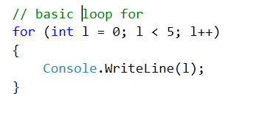
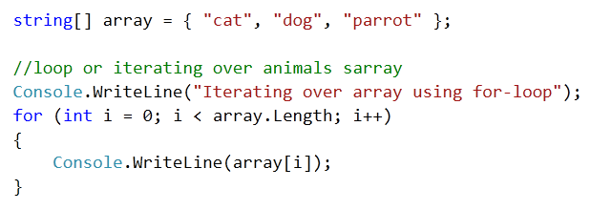
C# Fundamentals Control Structure
For-loops
for loop to allows run a statement or a block of statements repeatedly until a specified expression evaluates to false.

Slide 16
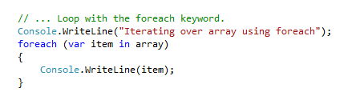
C# Fundamentals Control Structure
Foreach-loop
foreach statement is used to iterate through the collection,
it returns each element in order.

Slide 17
C# Fundamentals
Collections and Linq

Slide 18
C# Fundamentals Generic Collections
Lists
Sintaxis : List<TypeName> varName;
Represents a strongly typed list of objects that can be accessed by index. Provides methods to search, sort, and manipulate lists.

Slide 19
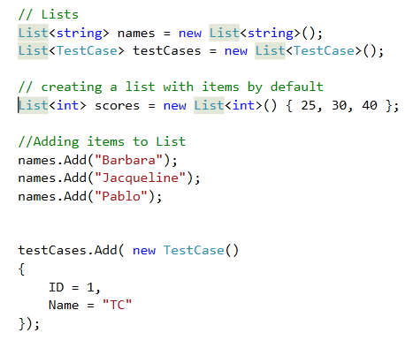
C# Fundamentals Generic Collections
Lists

Slide 20
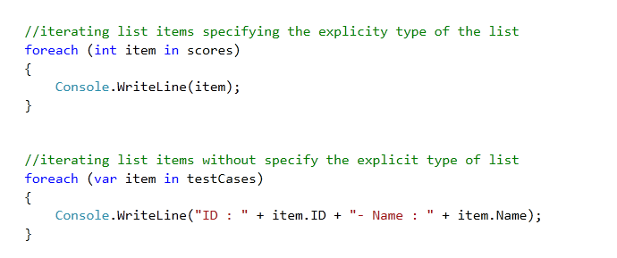
C# Fundamentals Generic Collections
Iterating List items

Slide 21
C# Fundamentals Generic Collections
Dictionary
Sintaxis : Dictionary<KeyType, ValueType> varName;
Represents a collection of keys and values.

Slide 22
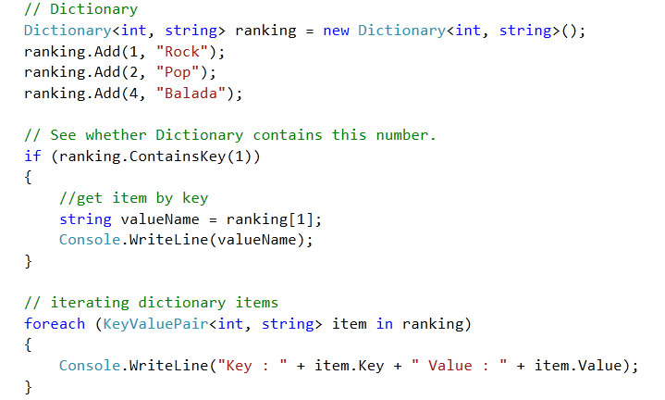
C# Fundamentals Generic Collections
Dictionary

